Slide 1
Spring Framework

Slide 2
Prerequisites
Core Java

Slide 3
Introduction
Spring is a lightweight framework. It can be thought of as a framework of frameworks because it provides support to various frameworks such as Struts, Hibernate, Tapestry, EJB, JSF etc. The framework, in broader sense, can be defined as a structure where we find solution of the various technical problems.
The Spring framework comprises several modules such as IOC, AOP, DAO, Context, ORM, WEB MVC etc

Slide 4
Inversion Of Control (IOC) and Dependency Injection
design patterns that are used to remove dependency from the programming code
class Employee{
Address address;
Employee(){
address=new Address();
}
}
class Employee{
Address address;
Employee(Address address){
this.address=address;
}
}
Advantage of Dependency Injection
makes the code loosely coupled so easy to maintain
makes the code easy to test

Slide 5
Advantages of Spring Framework
1) Predefined Templates
Spring framework provides templates for JDBC, Hibernate, JPA etc. technologies. So there is no need to write too much code. It hides the basic steps of these technologies.
Let's take the example of JdbcTemplate, you don't need to write the code for exception handling, creating connection, creating statement, committing transaction, closing connection etc. You need to write the code of executing query only. Thus, it save a lot of JDBC code.
2) Loose Coupling
The Spring applications are loosely coupled because of dependency injection.
3) Easy to test
The Dependency Injection makes easier to test the application. The EJB or Struts application require server to run the application but Spring framework doesn't require server.
4) Lightweight
Spring framework is lightweight because of its POJO implementation. The Spring Framework doesn't force the programmer to inherit any class or implement any interface. That is why it is said non-invasive.
5) Fast Development
The Dependency Injection feature of Spring Framework and it support to various frameworks makes the easy development of JavaEE application.
6) Powerful abstraction
It provides powerful abstraction to JavaEE specifications such as JMS, JDBC, JPA and JTA.
7) Declarative support
It provides declarative support for caching, validation, transactions and formatting.

Slide 6
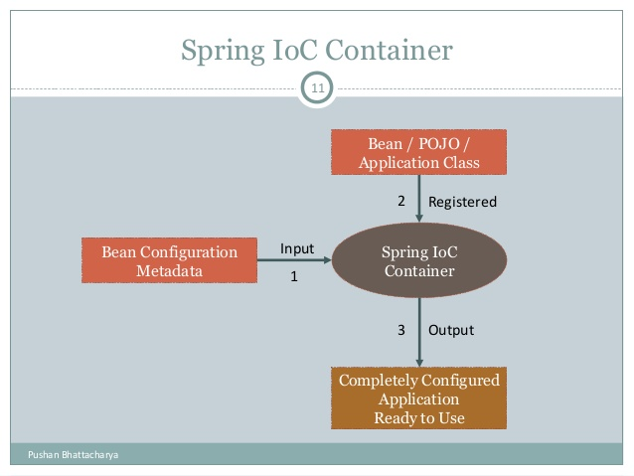

Slide 7
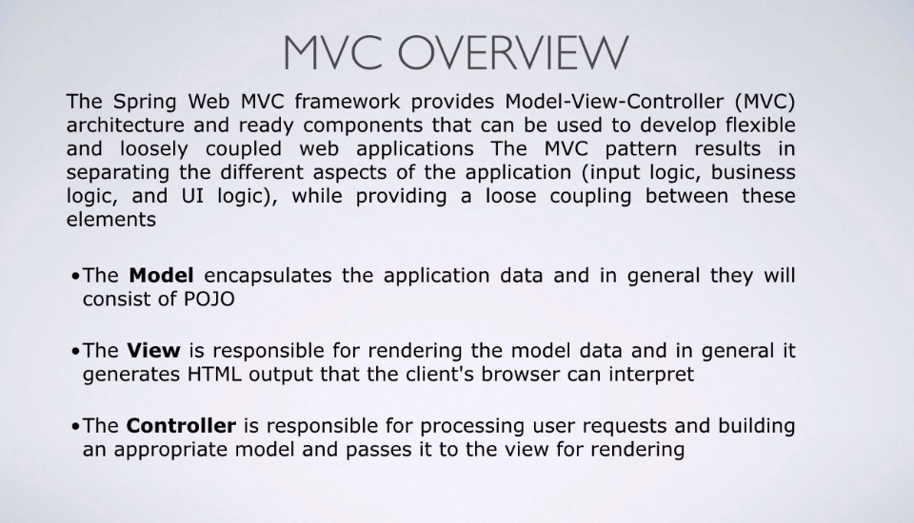

Slide 8
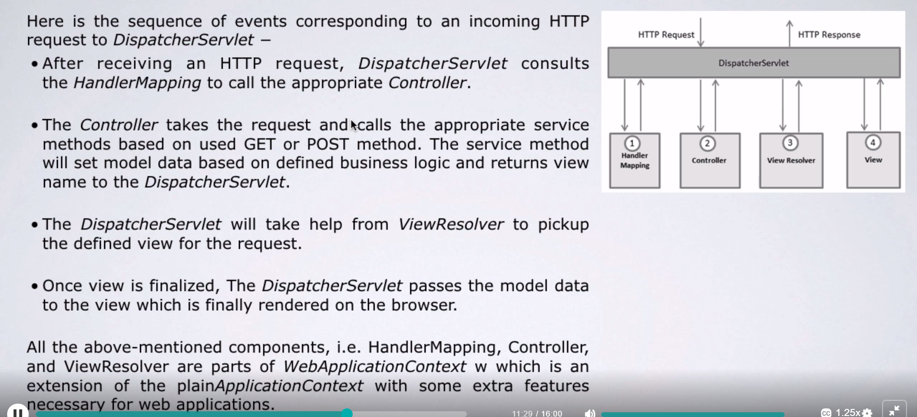
DispatcherServlet

